Slide 1
Aakash Goel https://www.linkedin.com/in/goelaakash123/
Session 6:
Harris Corner Detector, HoG & Applications
Acknowledgement: Slide Materials adopted from - Intro to Computer Vision (Cornell Tech); Noah Snavely, prepared by the lead instructor Prof S P Vimal , modified (added some content) by Aakash Goel

Slide 2
Topics
Harris Corner detector
Histogram of Oriented Gradients
Adopted from (1) Rick Szeliski’s lecture notes, CSE576, Spring 05 (2) CS5670: Computer Vision - Local features & Harris corner detection

Slide 3
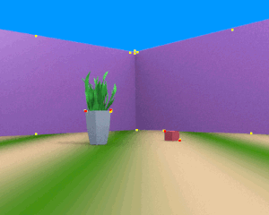
Corner Detection
What is Corner Detection? Corner detection is a fundamental technique in computer vision used to identify points in an image where there is a significant change in both the horizontal and vertical directions. These points, known as corners, typically occur at the intersection of two edges and represent distinct, stable features in an image.
Why Corners Matter? Corners are important because they are highly distinctive, invariant under scaling, rotation, and illumination changes, making them robust for tasks like object recognition, image matching, and motion tracking.
https://en.wikipedia.org/wiki/Corner_detection

Slide 4
Corner Detection - What
A corner is a point where intensity changes in all directions.
Unlike edges (where change is in one direction), corners are unique because:
Moving in any direction gives a large intensity change.
Think of it as a “interesting” or “distinctive” point in an image.

Slide 5
Corner Detection - Why
Feature | Why it Matters
Highly Distinctive | Easy to recognize uniquely across images
Repeatable | Same corners appear even under transforms
Invariant to Scale & Rotation | Useful in images taken from different views or zoom levels
Robust to Illumination Change | Corners remain detectable under light changes
Geometrically Stable | Stay in the same place even with camera motion

Slide 6
Applications of Corner Detection
Object Recognition: Corners provide unique, stable features that help in identifying and recognizing objects within an image. These features are used in object recognition algorithms, particularly in applications like facial recognition, logo detection, and tracking specific items.
Image Matching: Corners are used for matching images in different conditions, such as rotation, scaling, or changes in viewpoint. They are helpful in tasks like panorama stitching, where different images are aligned to form a larger image.
Feature Tracking: In video or motion analysis, corner points are tracked over time to follow the movement of objects or parts of an image. This is used in optical flow estimation, motion tracking, and dynamic scene analysis.
Camera Calibration: Corner detection is used in the calibration of cameras, where the 2D positions of known 3D points (like the corners of a checkerboard) are used to compute the intrinsic and extrinsic parameters of the camera.
3D Reconstruction: In stereo vision, corners are crucial for estimating depth information from multiple views. Correspondences between corner points in different views are used to reconstruct the 3D geometry of objects.
Robotics and Navigation: Robots use corner detection for feature-based localization and mapping, as well as obstacle detection and avoidance. By identifying corners in the environment, a robot can navigate or map its surroundings effectively.
Augmented Reality (AR): In AR applications, corner detection helps track physical objects or surfaces in real-time to overlay digital content accurately. For example, detecting corners on a table to place virtual objects in a scene.
Document Analysis and OCR: In optical character recognition (OCR), corners of text blocks or documents help segment the text and identify the structure of the page, improving text extraction accuracy.
Video Compression: Corner detection helps in compressing video data by focusing on the movement of key features (like corners) rather than entire frames, reducing redundancy in video encoding.
Motion Analysis: In sports or surveillance, corner detection can be used to track significant changes in object motion, such as identifying player movements or vehicles in traffic analysis.

Slide 7
Corner Detection - Application
Task | Role of Corners
Image Matching | Match same scene/object across different images (e.g. panorama stitching)
Object Recognition | Recognize an object from different views
Motion Tracking | Track movement in video (optical flow, SLAM)
3D Reconstruction | Use correspondences between frames
Feature Descriptors | Corners are great places to describe a patch (e.g. SIFT, SURF)

Slide 8
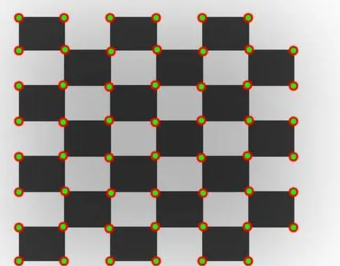
Key Techniques for Corner Detection
Common corner detection algorithms include the Harris Corner Detector and the Shi-Tomasi Corner Detector, which evaluate the local image structure to identify these critical points.
This technique forms the backbone for numerous applications across fields such as robotics, augmented reality, and image processing, enhancing the accuracy and efficiency of visual systems.
https://medium.com/@deepanshut041/introduction-to-harris-corner-detector-32a88850b3f6

Slide 9
Corner Detection Algorithms
1. Harris Corner Detector
Uses the change in intensity in all directions.
Based on the second moment matrix (structure tensor) of gradients in a window.
Strength of a corner is determined by eigenvalues of this matrix.
2. Shi-Tomasi Corner Detector
A refinement of Harris.
Uses minimum eigenvalue as corner score — more robust.

Slide 10
Harris corner detector
C.Harris, M.Stephens. “A Combined Corner and Edge Detector”. 1988

Slide 11
Intuition: Harris corner detector
Think of placing a small window over a part of the image and shifting it:
Flat region: No significant change in intensity when shifted → Not useful.
Edge: Change only in direction perpendicular to edge → Ambiguous.
Corner: Significant change in all directions → Ideal for detection.

Slide 12
Local measures of uniqueness
Suppose we only consider a small window of pixels
What defines whether a feature is a good or bad candidate?
Credit: S. Seitz, D. Frolova, D. Simakov
Notes:
High level idea is that corners are good. You want to find windows that contain strong gradients AND gradients oriented in more than one direction

Slide 13
Local measures of uniqueness
How does the window change when you shift it?
Shifting the window in any direction causes a big change
“flat” region: no change in all directions
“corner”: significant change in all directions
“edge”:
no change along the edge direction
Credit: S. Seitz, D. Frolova, D. Simakov

Slide 14
The Basic Idea
We should easily recognize the point by looking through a small window
Shifting a window in any direction should give a large change in intensity

Slide 15
Harris Detector: Basic Idea
“flat” region: no change in all directions
“edge”: no change along the edge direction
“corner”: significant change in all directions

Slide 16
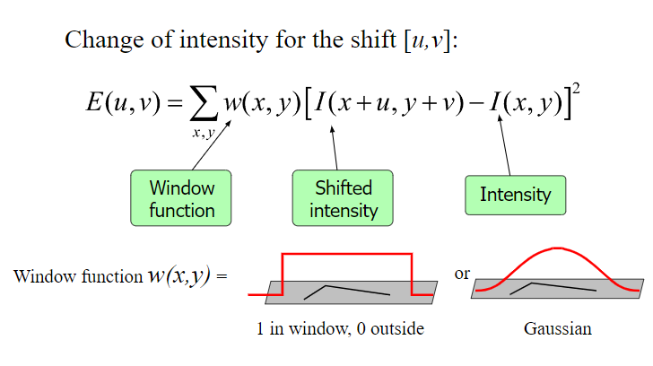
Harris Detector: Mathematics
We are trying to detect a corner by checking how much the intensity changes when we shift a small window by [u,v] (small horizontal and vertical movements) in an image.
Take every pixel (x,y) in the window. Compare its intensity to the pixel at the shifted position (x+u,y+v). Square the difference. Weight it by a function w(x,y),and add up over the whole window.

Slide 17
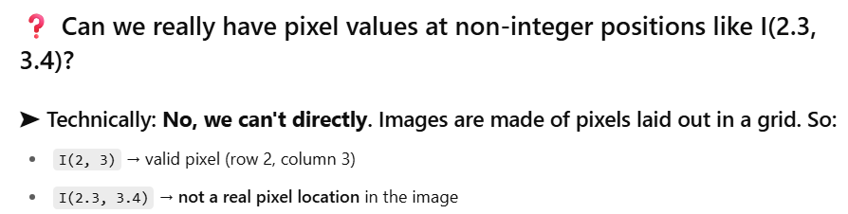
Harris Detector: Mathematics (Taylor Intuition)
❓ So where's the problem?
We can’t directly compute I(x+u,y+v) unless u and v are integers — which they’re not!
We often want to evaluate how the function behaves with tiny sub-pixel movements (e.g., u=0.2, v=−0.1).

Slide 18
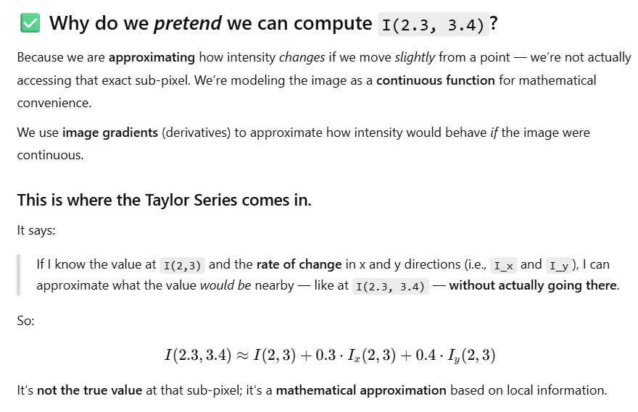
Harris Detector: Mathematics (Taylor Intuition)
❓ So where's the problem?
We can’t directly compute I(x+u,y+v) unless u and v are integers — which they’re not!
We often want to evaluate how the function behaves with tiny sub-pixel movements (e.g., u=0.2, v=−0.1).

Slide 19
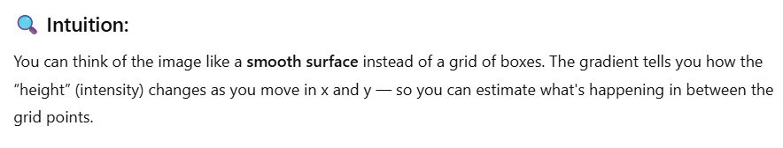
Harris Detector: Mathematics (Taylor Intuition)
❓ So where's the problem?
We can’t directly compute I(x+u,y+v) unless u and v are integers — which they’re not!
We often want to evaluate how the function behaves with tiny sub-pixel movements (e.g., u=0.2, v=−0.1).

Slide 20
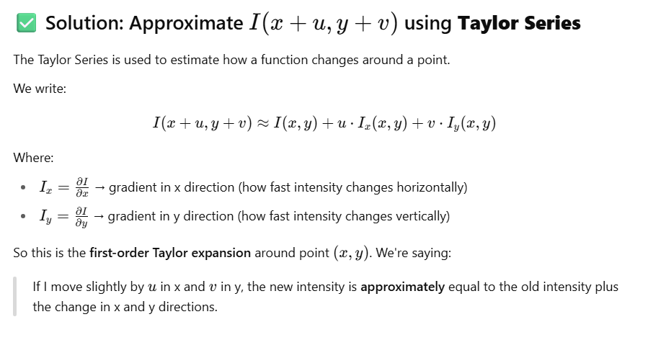
Harris Detector: Mathematics (Taylor)
❓ So where's the problem?
We can’t directly compute I(x+u,y+v) unless u and v are integers — which they’re not!
We often want to evaluate how the function behaves with tiny sub-pixel movements (e.g., u=0.2, v=−0.1).

Slide 21
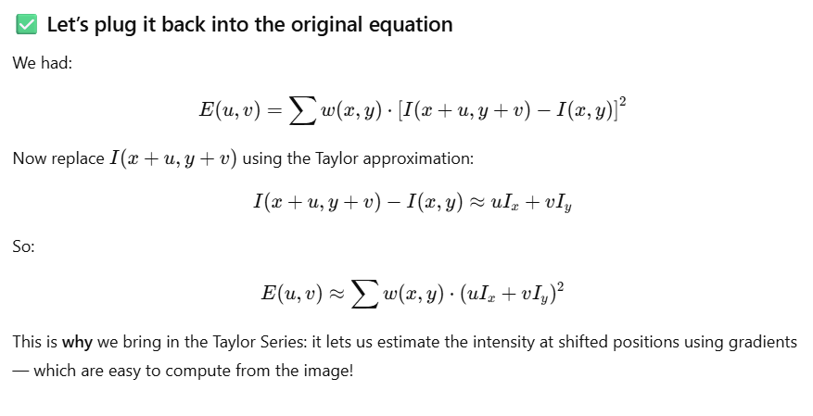
Harris Detector: Mathematics (Taylor)

Slide 22
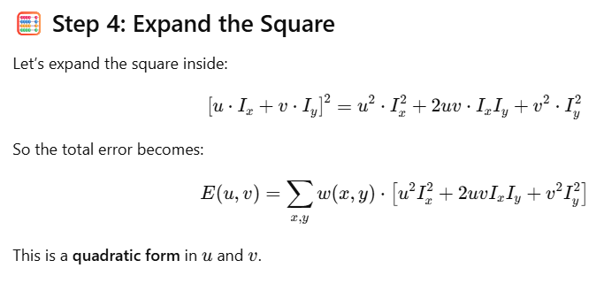
Harris Detector: Mathematics (Taylor)

Slide 23
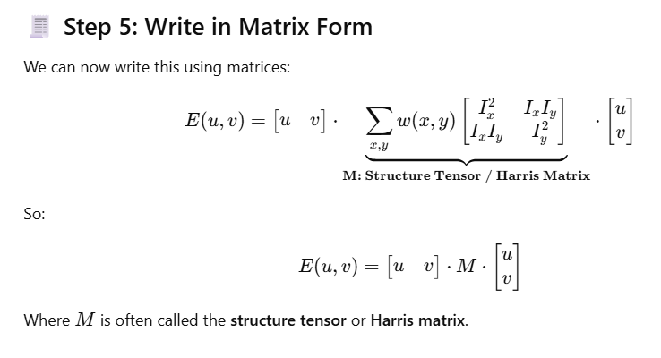
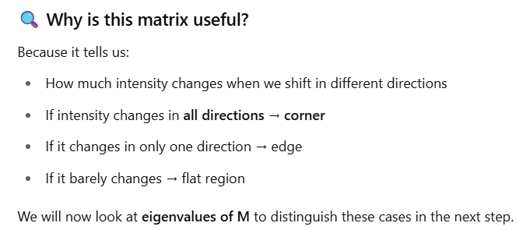
Harris Detector: Mathematics (Taylor)

Slide 24
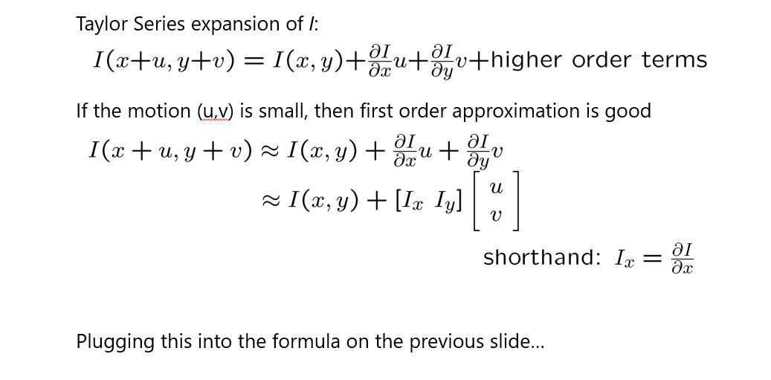
Harris Detector: Mathematics

Slide 25
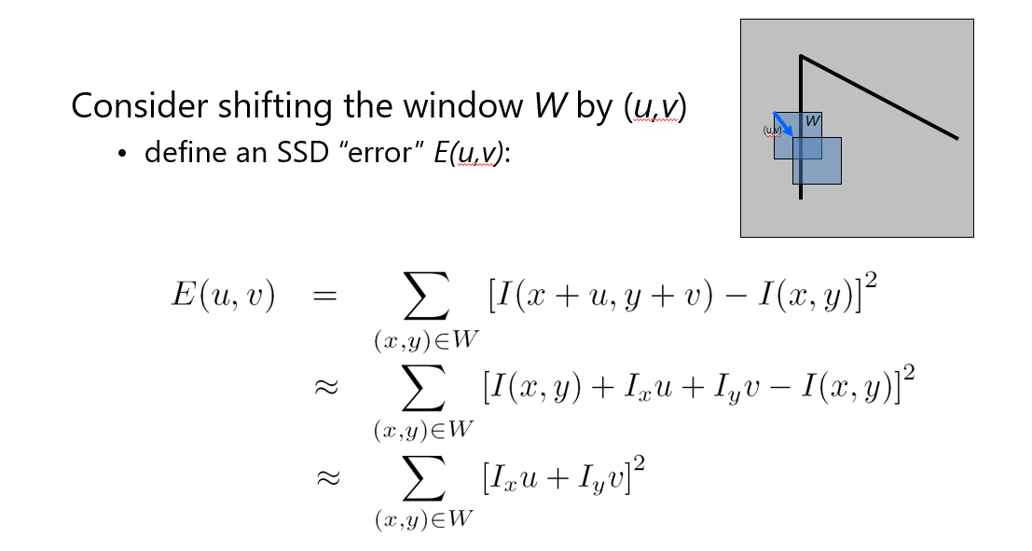
Harris Detector: Mathematics

Slide 26
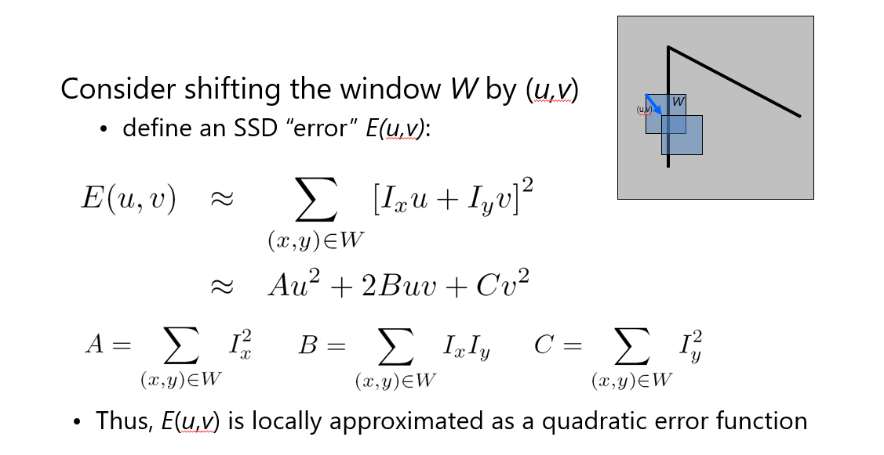
Harris Detector: Mathematics

Slide 27
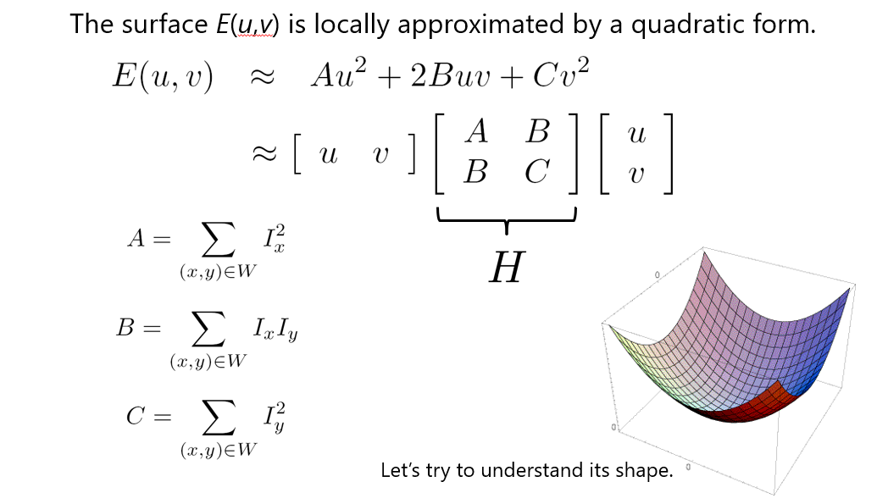
Harris Detector: Mathematics

Slide 28
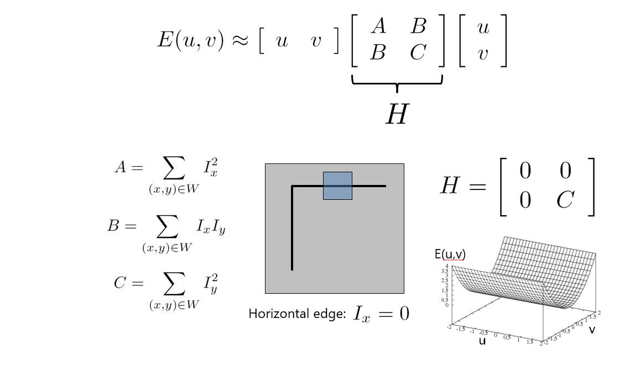
Harris Detector: Mathematics

Slide 29
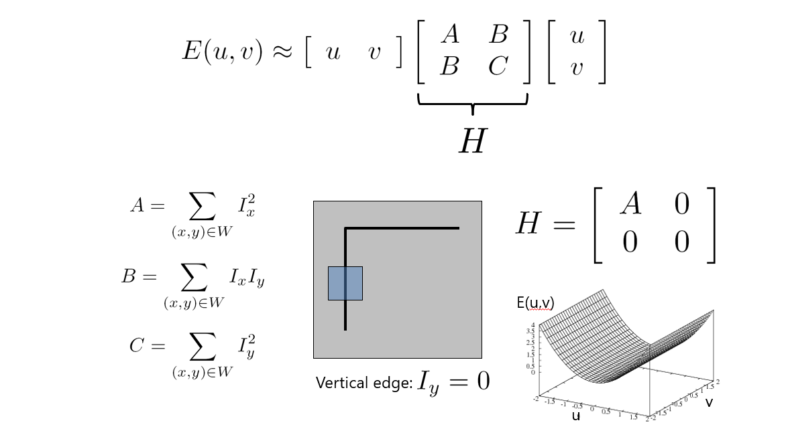
Harris Detector: Mathematics

Slide 30
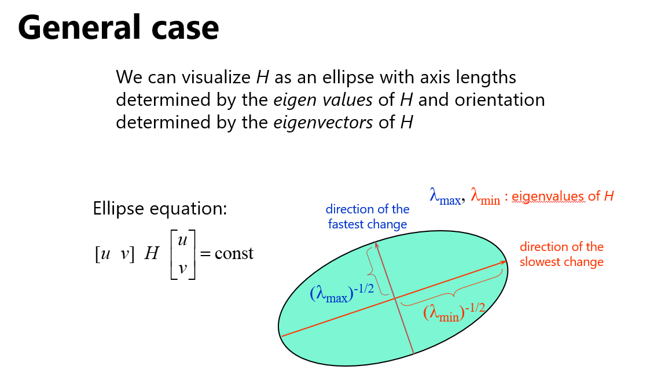
Harris Detector: Mathematics

Slide 31
Harris Detector: Mathematics

Slide 32
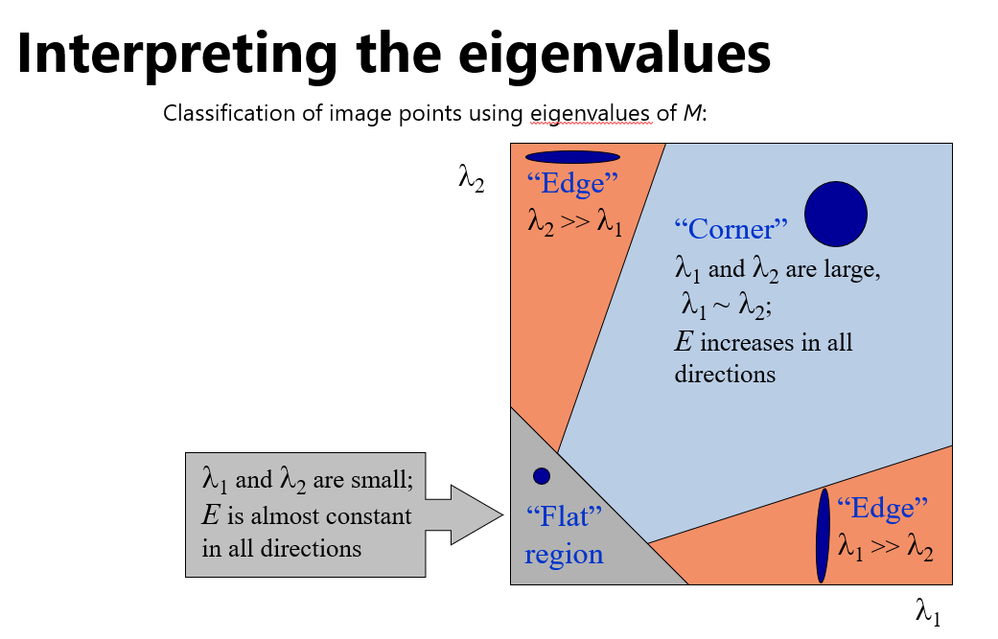
Harris Detector: Mathematics

Slide 33
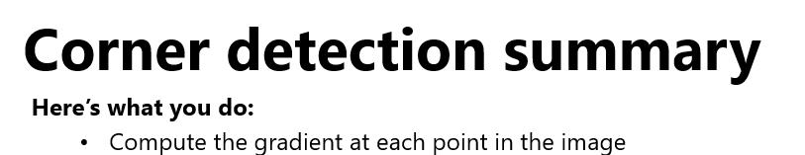
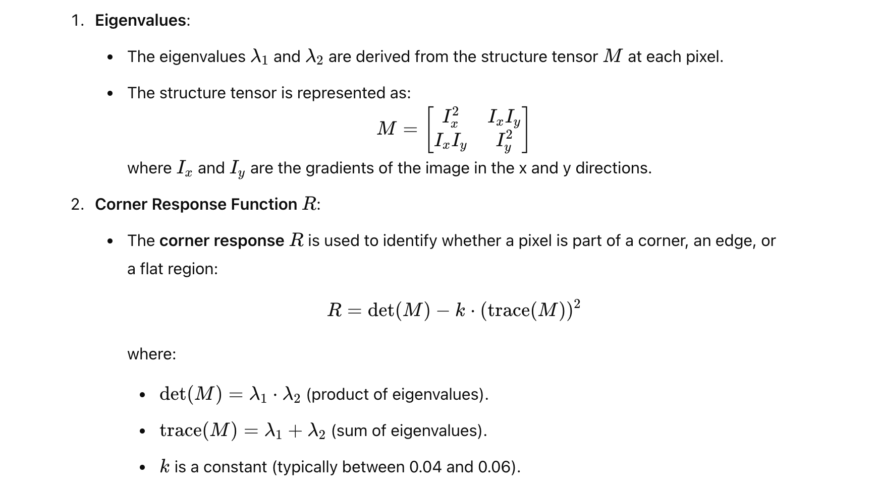
Harris Detector: Mathematics

Slide 34
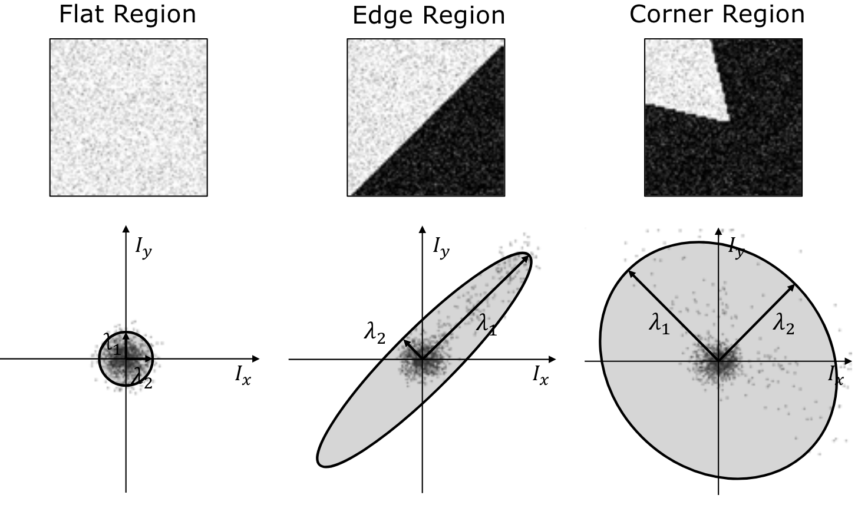
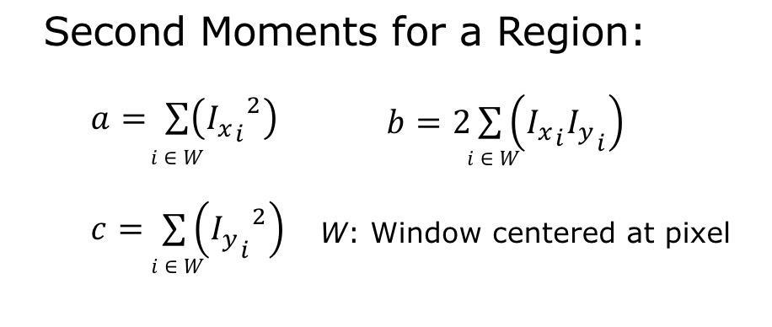
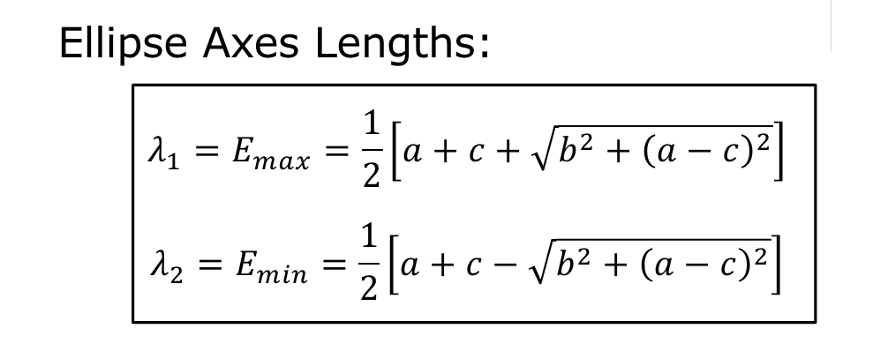
Finding values

Slide 35
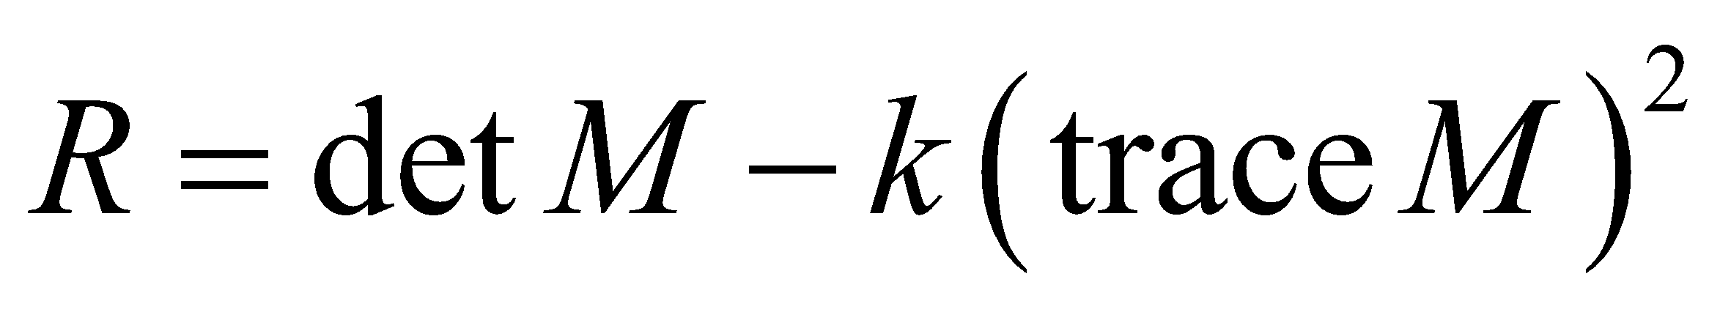
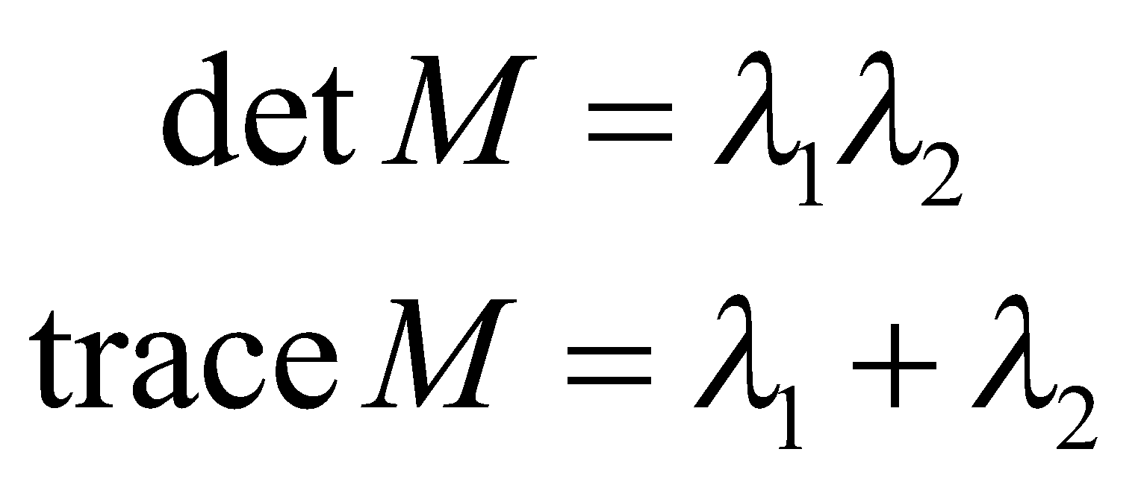
Harris Detector: Mathematics
Measure of corner response:
(k – empirical constant, k = 0.04-0.06)

Slide 36
Harris Detector: Mathematics
λ₂
“Edge”
“Corner”
R depends only on eigenvalues of M
R is large for a corner
R is negative with large magnitude for an edge
|R| is small for a flat region
R < 0
R > 0
“Flat”
“Edge”
|R| small
R < 0
λ₁

Slide 37
Harris Detector
The Algorithm:
Find points with large corner response function R (R > threshold)
Take the points of local maxima of R

Slide 38
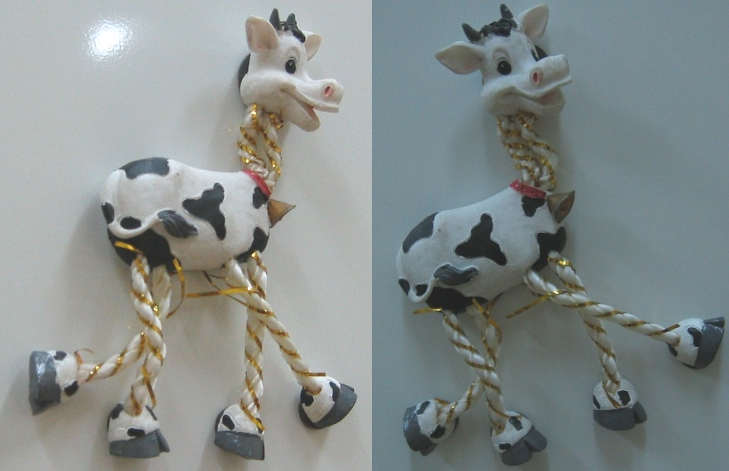
Harris Detector: Workflow

Slide 39

Harris Detector: Workflow
Compute corner response R

Slide 40

Harris Detector: Workflow
Find points with large corner response: R>threshold

Slide 41
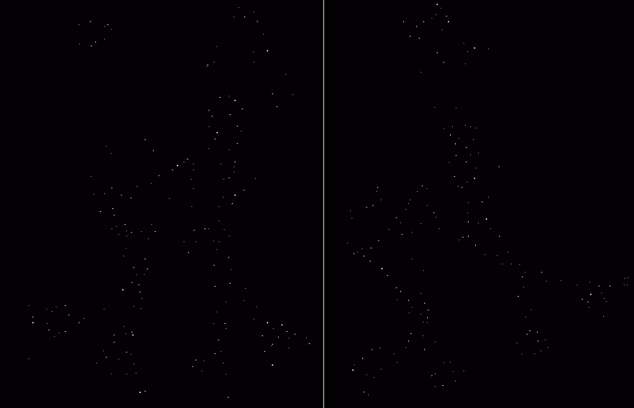
Harris Detector: Workflow
Take only the points of local maxima of R

Slide 42
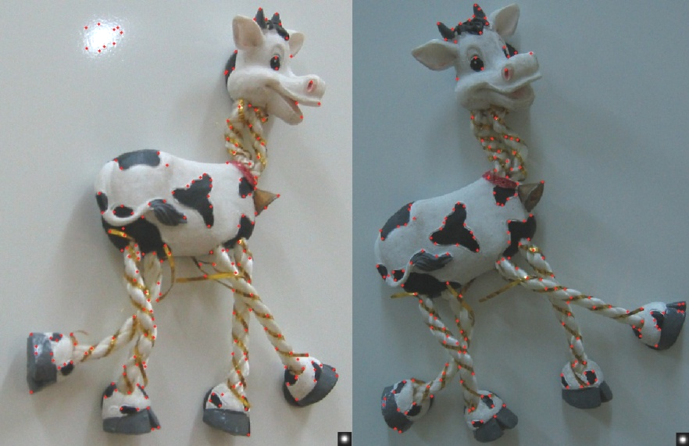
Harris Detector: Workflow

Slide 43
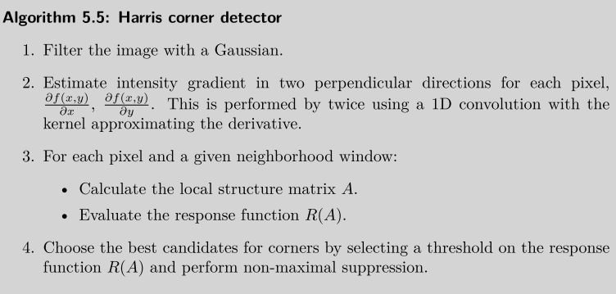

Slide 44
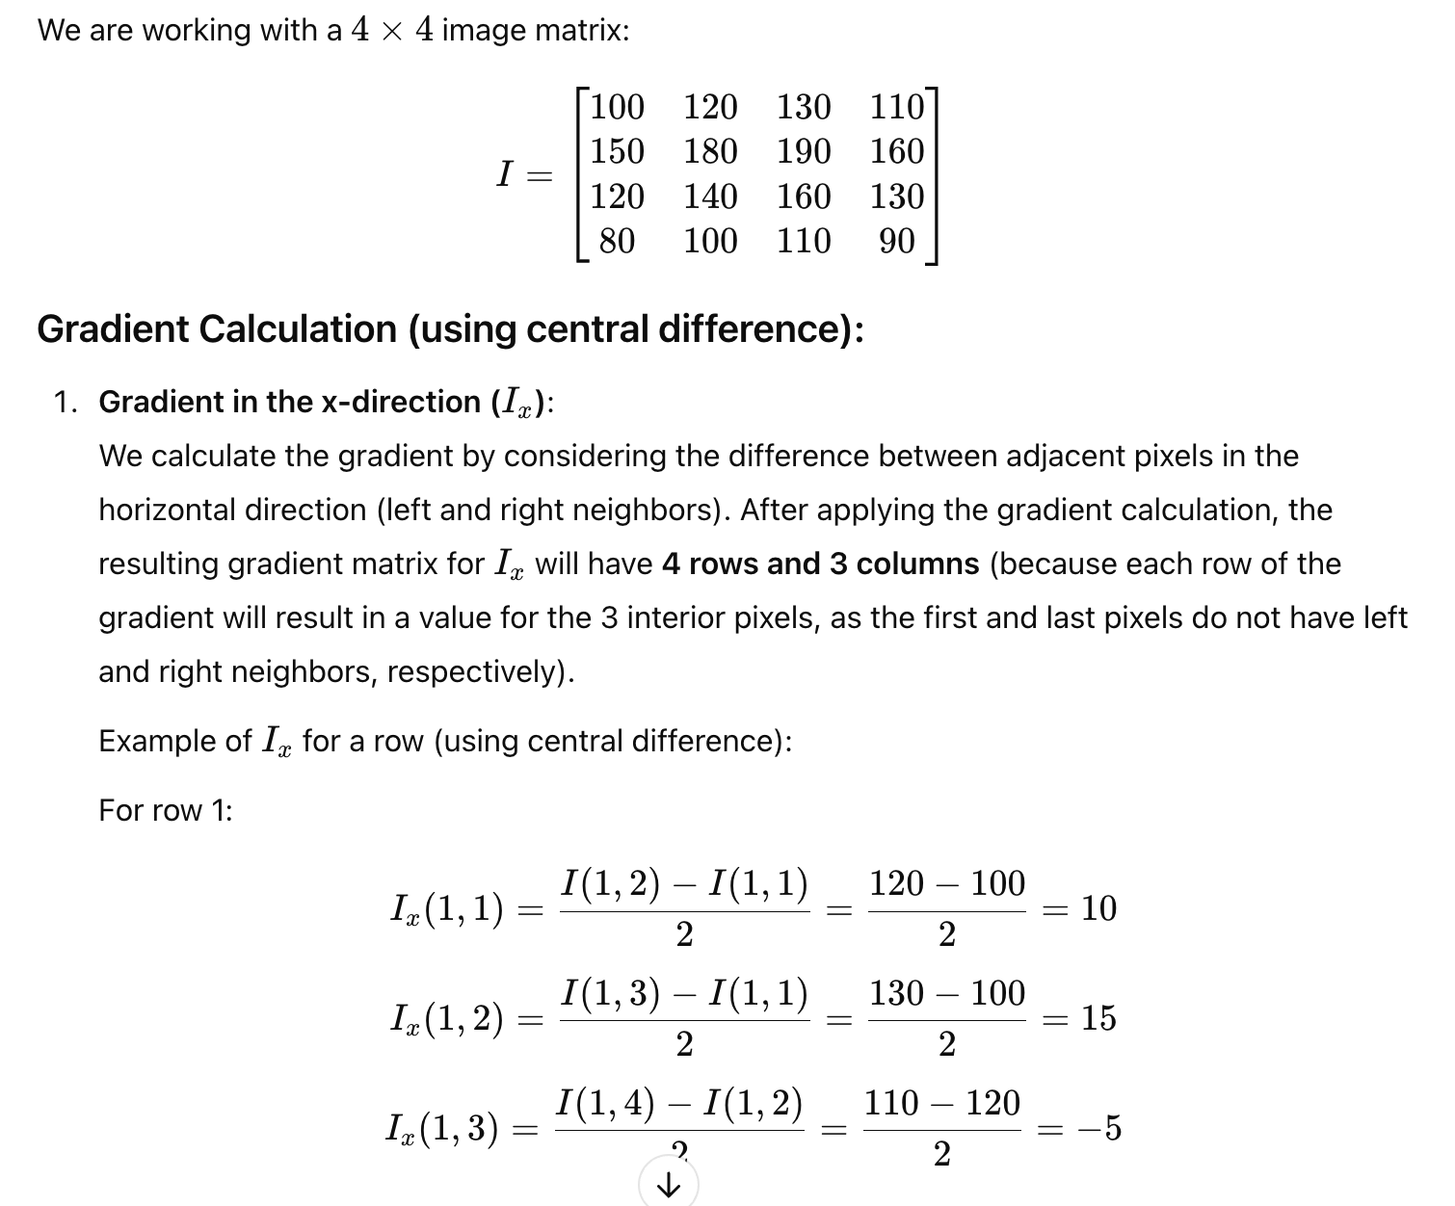
Harris Corner Detector- Numericals
CV 6: Harris and HoG

Slide 45
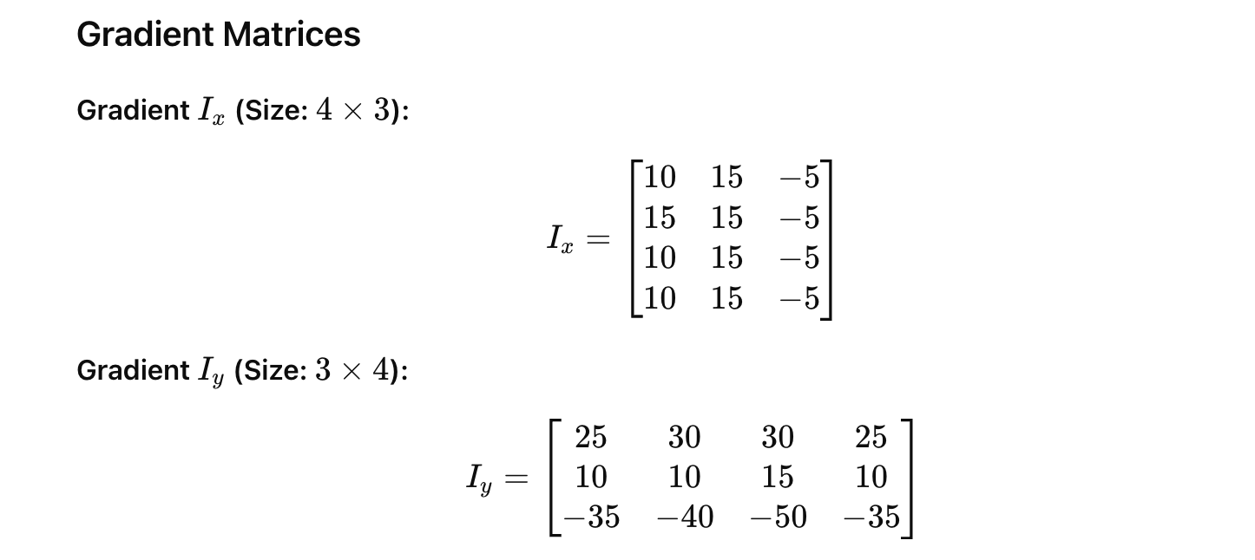
Harris Corner Detector- Numericals
CV 6: Harris and HoG

Slide 46
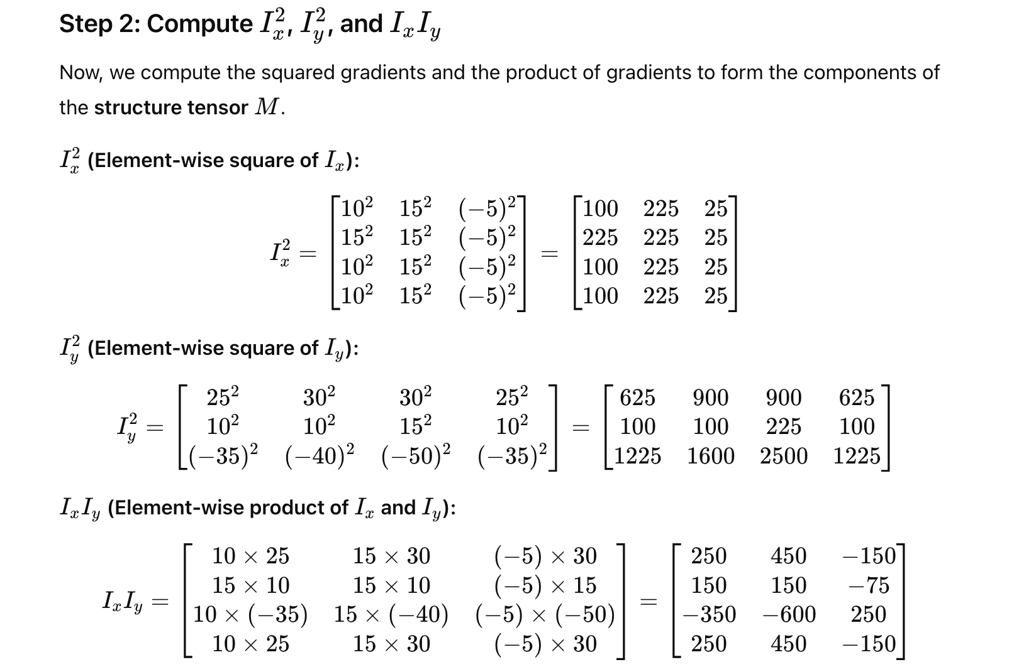
Harris Corner Detector- Numericals

Slide 47
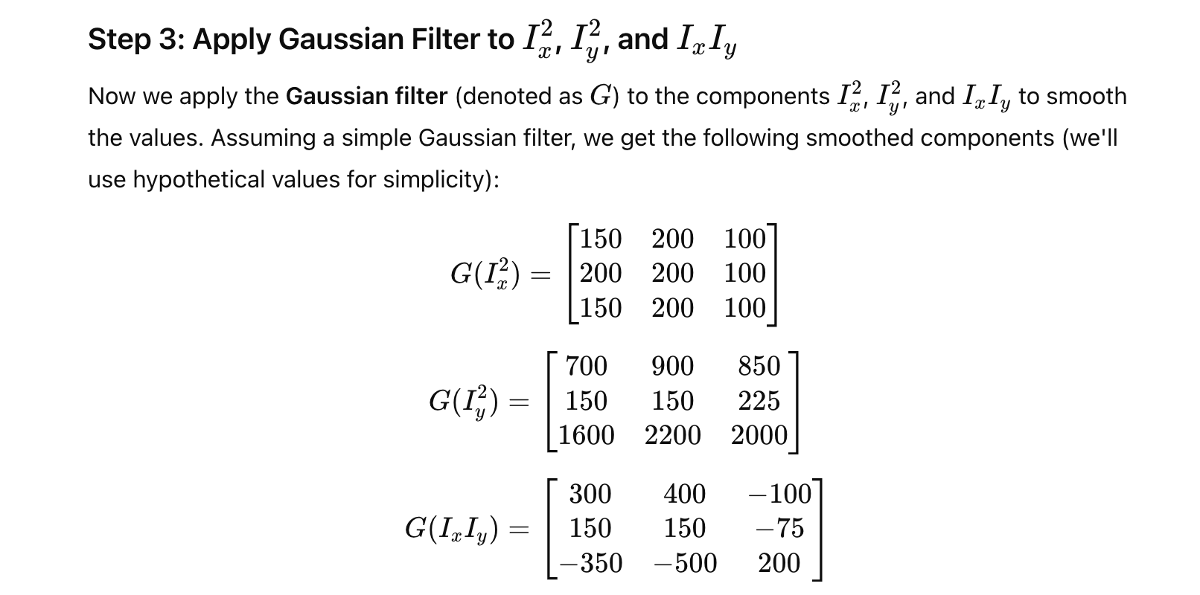
Harris Corner Detector- Numericals

Slide 48
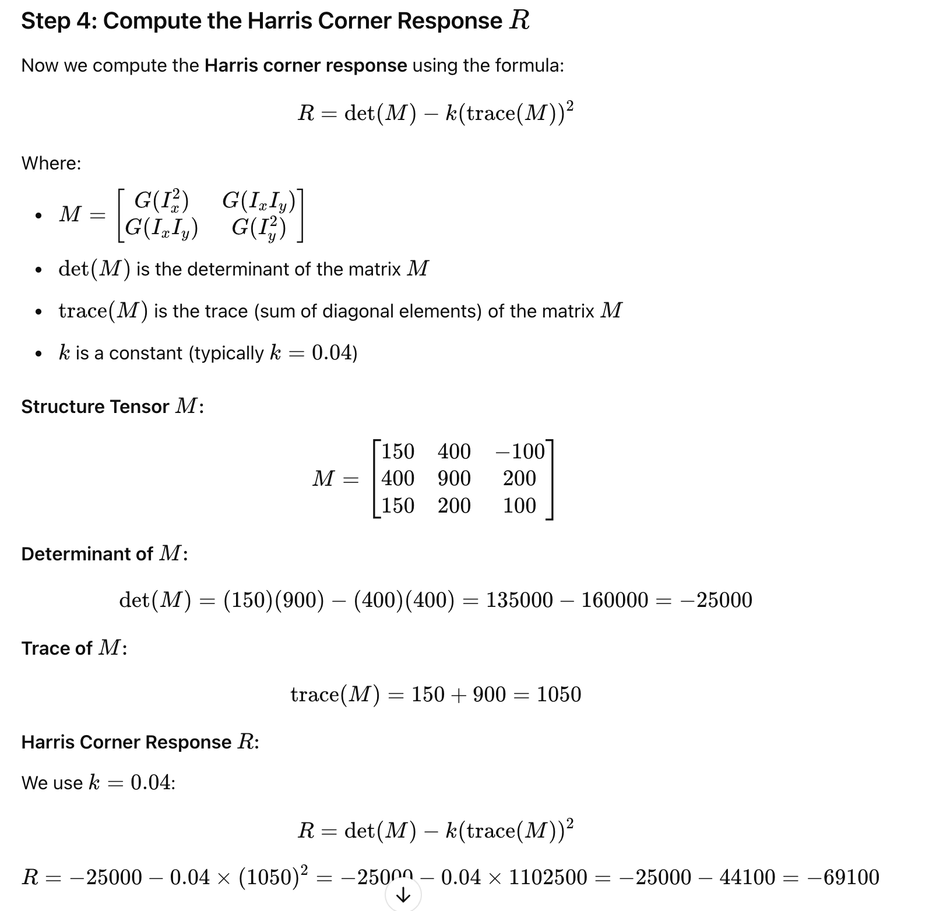
Harris Corner Detector- Numericals

Slide 49
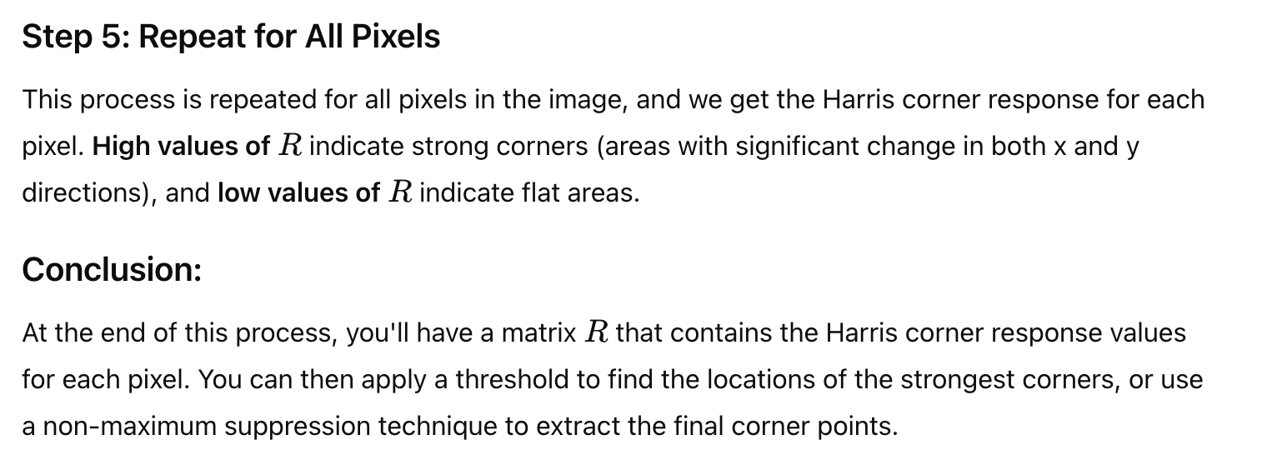
Harris Corner Detector- Numericals (contd..)

Slide 50
Histogram of Oriented Gradients (HOG)

Slide 51
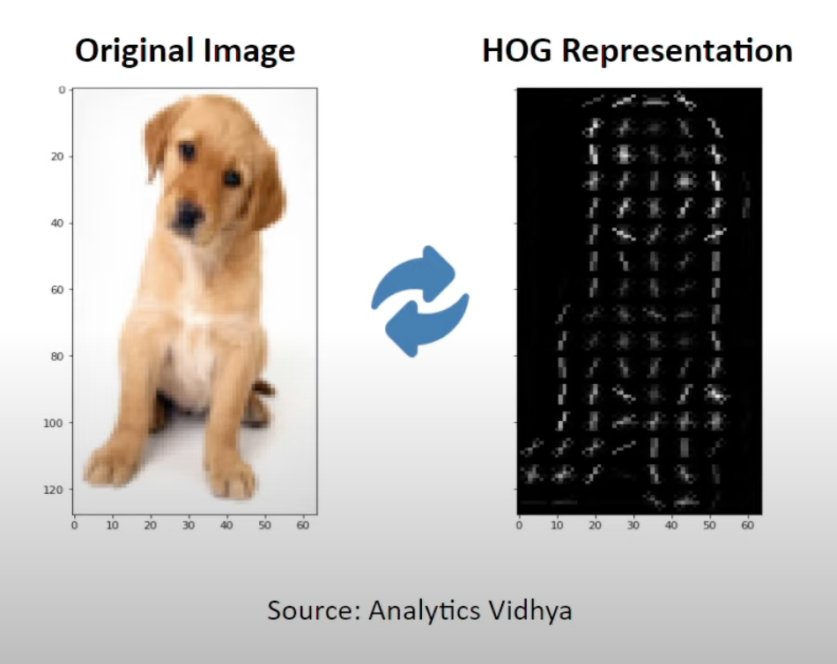
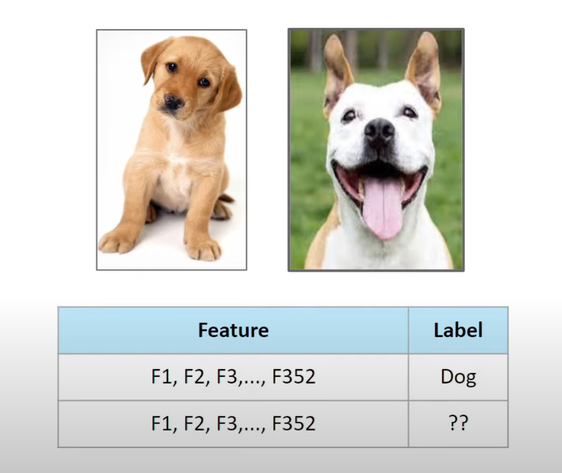
Histogram of Oriented Gradients (HOG) – An Introduction
CV 6: Harris and HoG
What is HOG?
HOG is a feature descriptor used in image processing and computer vision for object detection.
It captures the gradient orientation (or edge direction) of local regions in an image, providing a representation that can be used to recognize patterns and objects.
https://www.youtube.com/watch?v=5nZGnYPyKLU

Slide 52
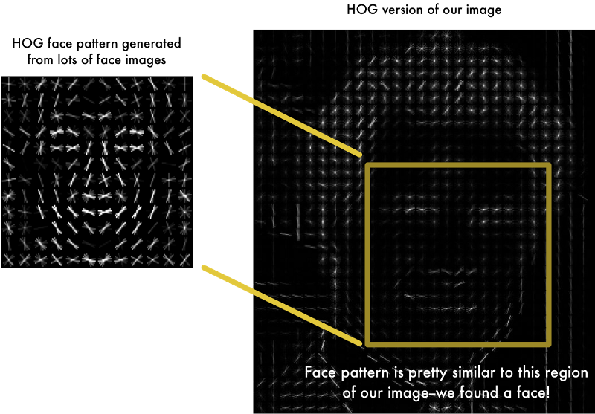
Applications of HOG
CV 6: Harris and HoG
Feature Extraction: from image data
Object Detection: HOG features are commonly used in human detection (e.g., detecting pedestrians) and other object detection tasks.
Image Classification: HOG can be used as input to classifiers such as SVM (Support Vector Machine) to recognize specific objects.
Face Recognition: HOG features can aid in facial feature detection by capturing relevant edge and texture information.
Surveillance Systems: Used in video surveillance for detecting objects, pedestrians, or vehicles.

Slide 53
Key Concepts
Gradient: Measures the intensity change in an image. The gradient direction indicates the edge direction.
Cells & Blocks:
The image is divided into small cells (typically 8x8 pixels), and gradients are computed within these cells.
These cells are grouped into blocks (typically 2x2 cells) for normalization, which helps reduce the effect of lighting variations.
Orientation Histograms: For each cell, a histogram of gradient directions is created, capturing the distribution of edge directions.

Slide 54
Steps
Find horizontal and vertical gradients
Gradient Magnitude and orientations
Use a patch of 64 x 128
Divide the image into blocks of 8 x 8 cells
Slide over 2 x 2 block cells
Quantize the gradient orientation into 9 bins by gradient magnitude
Concatenate histograms into a feature of : 15 x 7 x 4 x 9 = 3780 dimensions.

Slide 55
Find horizontal and vertical gradients
Gradient Magnitude and orientations
∂f
∂x
g_{x}
f (x + d ) − f (x − d )
∇f (x, y) = _{[gy]} =
∂f
= lim
d→0
2d
∂ y
Filter Masks:
-1 | 0 | 1
-1
0
1
Gradient Magnitude:
g = g² + g²
x y
θ = tan⁻¹( ^{gy} )
Gradient Orientation:
g_{x}

Slide 56



Blocks and Cells
Use a patch of 64 x 128
128
64

Slide 57





Divide the image into blocks of 8 x 8 cells Slide over 2 x 2 block cells
8
Block 2
8
Cells
Block 1
8 x 16 blocks with an overlap
Total blocks: 7x15
Each block is 2 x 2 of 8x8 cells

Slide 58
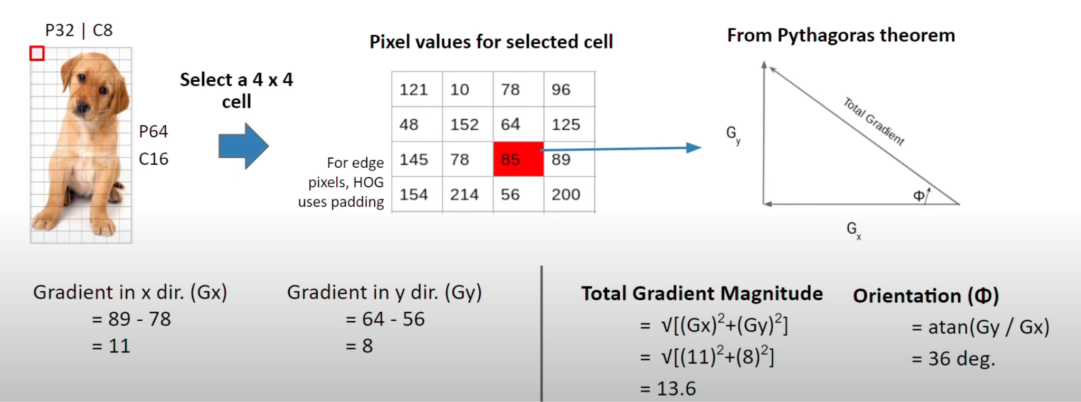
Calculate Gradient and Orientation

Slide 59








Histogram bins
Quantize the gradient orientation into 9 bins by gradient magnitude
100
80
60
140
120
40
20
160

Slide 60















Histogram bins
Quantize gradient orientations into 9 bins
100
80
60
140
120
40
20
160
70 35 5 10 64 0
57 85160 0 120 65
2 5 4 85 2 0
106 12 13 77 3 6
22 45 90145 30 18
37 86 48 180 12 37
108 3 87 33 81 27
23 54 11¹⁸⁶ ¹⁹ 114
12 4 134 6 75 57
43 30 23 5 119 14
67 57 98 11 9 77
3 11 23 54 78 90
7 ²¹⁰ 19 33 24 12
4
112 34 9 3 12
Gradient direction
Gradient Magnitude
 | 27 | 27 |  | 9 | 3
0 | 20 | 40 | 60 | 80 | 100 | 120 | 140 | 160

Slide 61
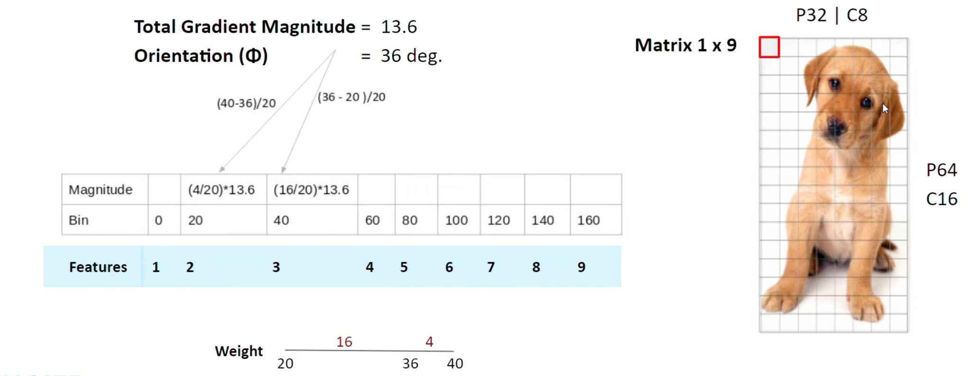
Gradient binning

Slide 62
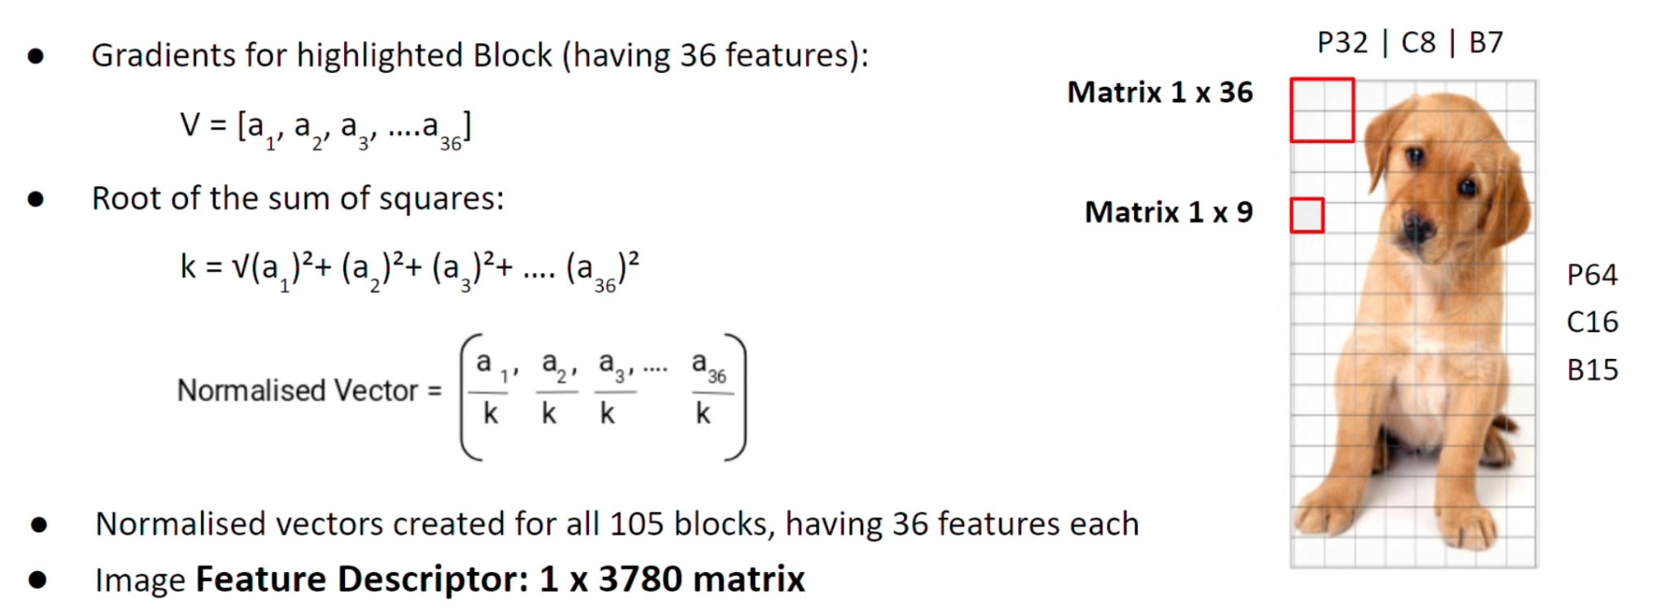
Normalisation

Slide 63
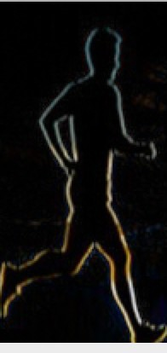
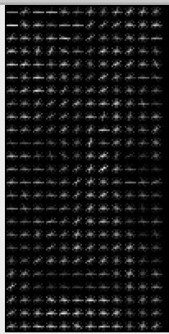
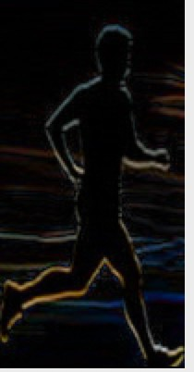
Concatenate Histograms
CV 6: Harris and HoG
15 x 7 * 9 * 4 = 3780

Slide 64
HOG Numericals
Let's consider a very small 5x5 image patch for simplicity. In a real scenario, HOG is applied to larger images and uses larger cells/blocks, but the core concepts remain the same.
Image Matrix (Grayscale):
[[80 70 50 70 90]
[85 75 55 75 95]
[90 85 60 80 100]
[95 90 65 85 105]
[100 95 70 90 110]]
Step 1: Gradient Computation
We'll use simple horizontal and vertical difference filters to approximate the gradients:
Gx (Horizontal Gradient Filter): [-1, 0, 1]
Gy (Vertical Gradient Filter): [-1, 0, 1]^T (Transpose)
We apply these filters by performing a convolution. For simplicity, we'll ignore the edge pixels (in a real implementation, you'd typically pad the image).
Calculating Gx (Horizontal Gradient):
For the element at (1,1) which is 75: (55 * -1) + (75 * 1) = 20
We calculate this for the central 3x3 part of the image.
Gx Matrix (central part):
[[20 20 20]
[25 20 25]
[25 20 25]]

Slide 65
HOG Numericals Contd..
Calculating Gy (Vertical Gradient):
For the element at (1,1) which is 75: (70 * -1) + (85 * 1) = 15
We calculate this for the central 3x3 part of the image.
Gy Matrix (central part):
[[15 15 15]
[10 10 10]
[5 5 5]]
Gradient Magnitude and Direction
Magnitude: sqrt(Gx^2 + Gy^2)
Direction (Angle in degrees): atan2(Gy, Gx) * (180 / pi) (atan2 handles all quadrants correctly)
Let's calculate these for the central 3x3 part:
Magnitude Matrix:
[[25.0 25.0 25.0]
[26.9 22.4 26.9]
[25.5 20.6 25.5]]
Angle Matrix (in degrees):
[[36.87 36.87 36.87]
[21.80 26.57 21.80]
[11.31 14.04 11.31]]

Slide 66
HOG Numericals Contd..
Step 2: Orientation Histograms in Cells
Let's assume our cell size is 3x3 (again, simplifying). We'll have one cell in this case, covering the central 3x3 part of our image.
We'll create a histogram with, say, 9 bins (0-20, 20-40, 40-60, ..., 160-180 degrees). For each pixel, we:
Find the bin corresponding to its angle.
Add its magnitude to that bin.
Creating the Histogram (for our single 3x3 cell):
Bin 1 (0-20): 25.5 + 20.6 + 25.5 = 71.6 (from angles 11.31, 14.04, 11.31)
Bin 2 (20-40): 25.0 + 25.0 + 25.0 + 26.9 + 22.4 + 26.9 = 151.2 (from angles 36.87, 36.87, 36.87, 21.8, 26.57, 21.8)
Bins 3-9 (40-180): 0 (No angles fall in this range in our example)
Our 9-bin histogram (for the 3x3 cell):
[71.6, 151.2, 0, 0, 0, 0, 0, 0, 0]

Slide 67
Summary
CV 6: Harris and HoG
This is a greatly simplified illustration of HOG. Here's a recap of the key differences in a full implementation:
Larger Images: Real images are much larger.
More Cells and Blocks: You'd divide the image into many cells and group cells into overlapping blocks.
More Histogram Bins: 9 bins are common, but you can use more.
Proper Edge Handling: Padding would be used to handle gradients at image edges.
Block Normalization: Crucial for robustness.
Sliding Window: HOG is often used with a sliding window to scan an entire image for object detection.

Slide 68
HOG Numericals Contd..
Step 3: Block Normalization
Since we only have one cell (due to our extreme simplification), we can't demonstrate block normalization here.
In a real scenario: You would group cells into larger blocks (e.g., 2x2 cells).
Normalization: You'd normalize the histogram of each cell within a block. Common methods are L1-norm, L2-norm, and L2-Hys. This makes the descriptor more robust to lighting changes.
Example of L2-norm (if we had a block):
Concatenate the histograms of all cells in the block.
Calculate the L2-norm of the concatenated vector: sqrt(sum(element^2))
Divide each element of the concatenated vector by the L2-norm.
Step 4: Final HOG Feature Vector
Again, since we have only one cell and no block normalization in this simplified example, our final HOG feature vector is simply the normalized histogram of our single cell.
Final HOG Vector (after hypothetical normalization):
Let's assume that after L2-normalization (which we can't perform with a single cell), the values in our histogram got scaled down. Our final vector could look like this (these are just example values after a hypothetical normalization):
[0.45, 0.89, 0, 0, 0, 0, 0, 0, 0]

Slide 69
Readings:
Histogram of Oriented Gradients:
Histogram of Oriented Gradients https://courses.cs.duke.edu/fall15/cps274/notes/hog.pdf
Histograms of Oriented Gradients for Human Detection Navneet Dalal and Bill Triggs https://lear.inrialpes.fr/people/triggs/pubs/Dalal-cvpr05.pdf
Harris Corner Detector
Milan Sonka , (Our Textbook-2) : Section 5.3.10
[ optional, yet recommended reading , Milan Sonka Section 5.3.11 ]
Notebook
https://github.com/mithunkumarsr/LearnComputerVisionWithMithun/blob/main/CV6_HarrisCornerDetection_HOG.ipynb

Slide 70
Thank you

